Slide 1
DiceWars
Simon Christofzik, Olga Lapidus(Gruppe 3)

Slide 2
Inhalt
Git
Scrum
Structure 101 (Architektur)
Sonar
Code Coverage(?)
Maven
Cost Estmation
Patterns
Dependency Injection
TUI Development
GUI Development

Slide 3
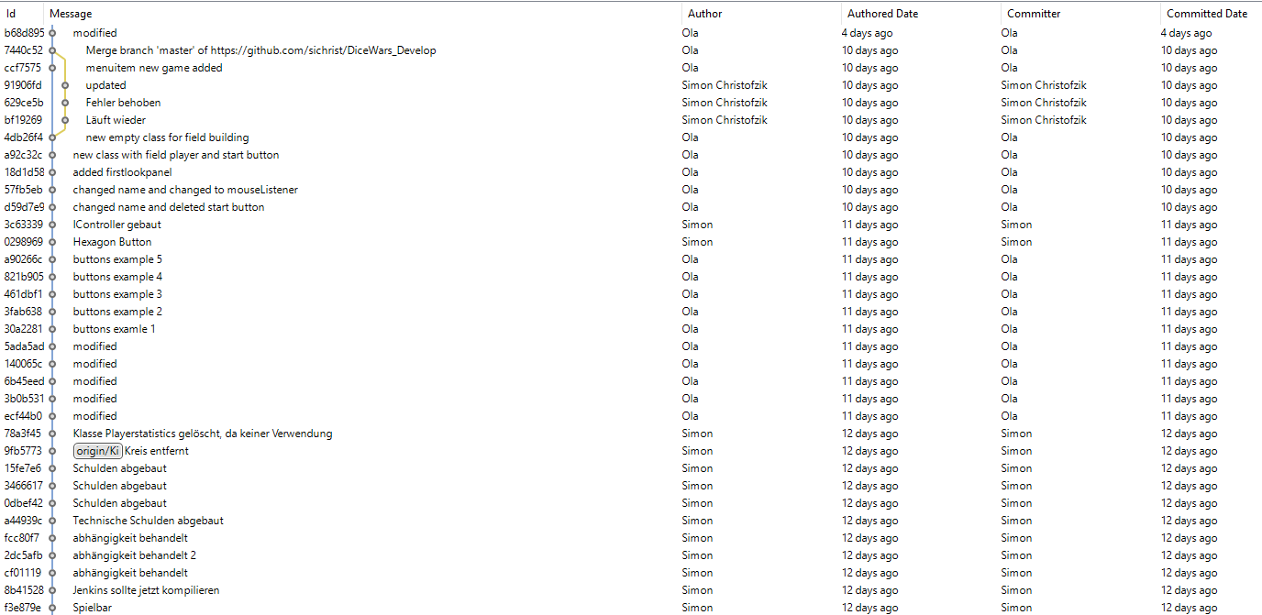
Git

Slide 4
Scrum

Slide 5
Structure 101, Architektur

Slide 6
Sonar

Slide 7
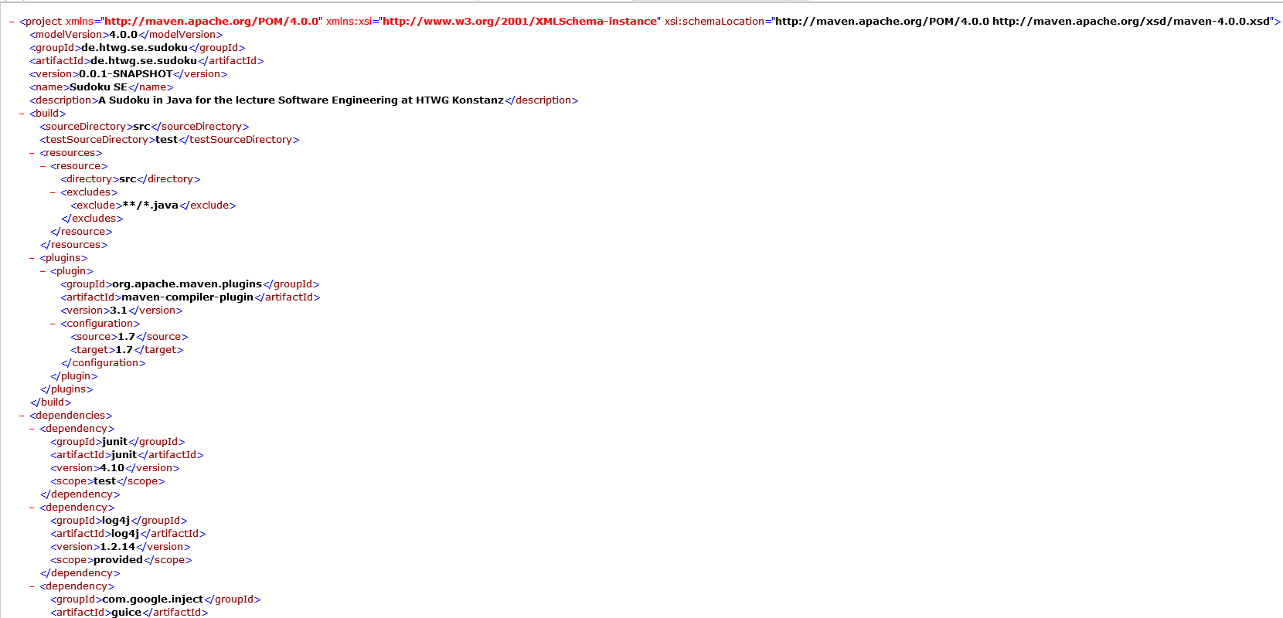
Pom

Slide 8
Cost Estimation

Slide 9
Patterns

Slide 10
Dependency Injection

Slide 11
TUI Development

Slide 12
GUI Development

